Slide 1
بسم الله الرحمن الرحیم
Notes:
Introduce yourself
ان شاء الله که وخت خوب و پربرکت خواهیم داشت

Slide 2
JS101 Introduction to Web Programming with Javascript

Slide 3
Behind the Scene
Notes:
learning the internals of browser operations helps you make better decisions and know the justifications behind development best practices.

Slide 4
browser
Rendering Engine
JavaScript Engine

Slide 5
JavaScript Engine
Browser API
Core JavaScript Language

Slide 6
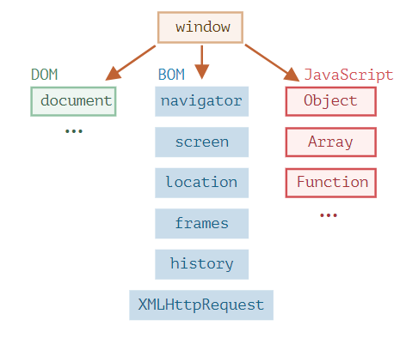
Notes:
The JavaScript language was initially created for web browsers. Since then, it has evolved into a language with many uses and platforms.
A platform may be a browser, or a web-server or another host, or even a “smart” coffee machine if it can run JavaScript. Each of these provides platform-specific functionality. The JavaScript specification calls that a host environment.

Slide 7
Browser API
Core Language
Variables: let, const, var
Loops: for, while
Conditionals: if-else, switch
Functions: side-effects, arguments, return value
Global objects
DOM API
Fetch API
Device API
Canvas API
Storage API
WebRTC

Slide 8
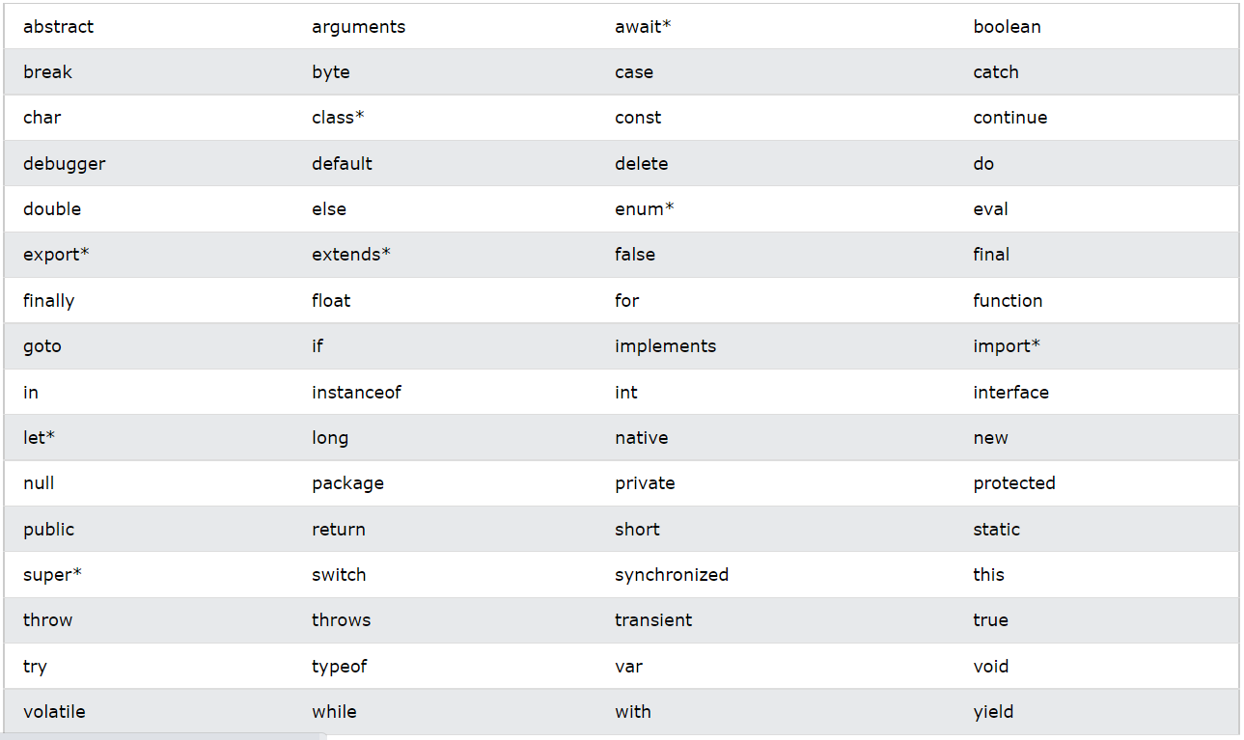

Slide 9
JavaScript Engine
Source Code
Machine Code
Notes:
Credit: https://web.dev/howbrowserswork/

Slide 10
Events

Slide 11
Events
onblur onchange onclick ondrag onfocus onkeyup onload onmousedown onmouseover onmouseup onsubmit ontouchmove onunload

Slide 12
querySelector

Slide 13
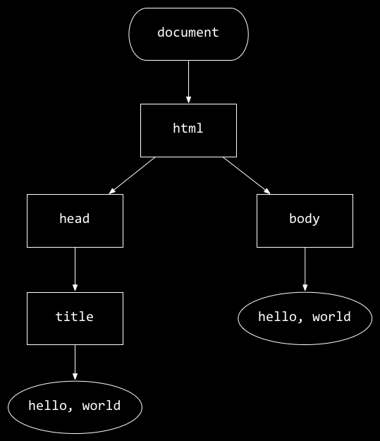
<!DOCTYPE html>
<html lang="en">
<head>
<title>
hello, title
</title>
</head>
<body>
hello, body
</body>
</html>
hello, body
hello, title

Slide 14
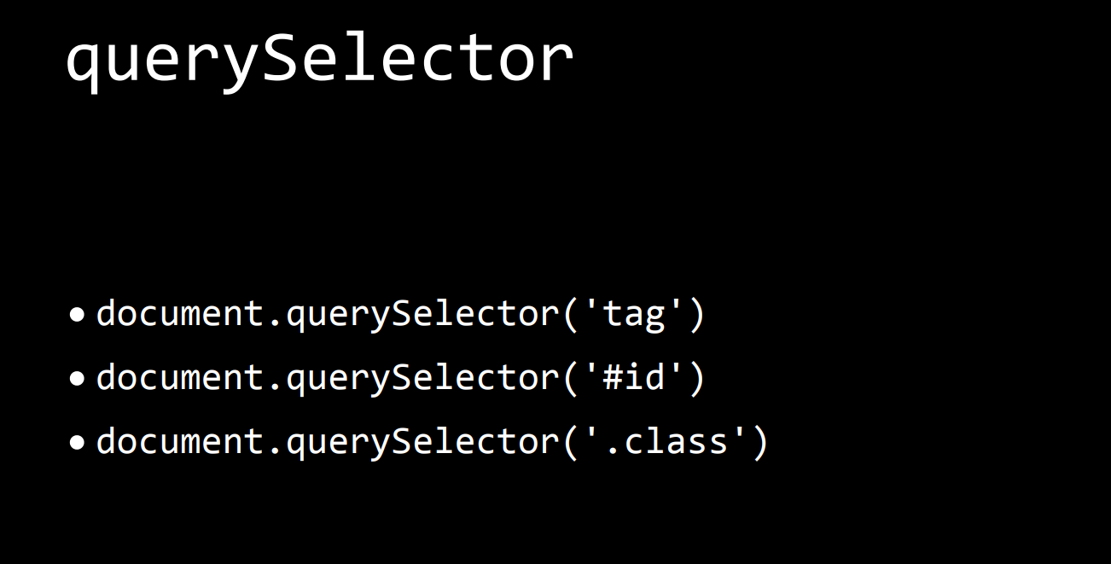

Slide 15
Functions
Side-effects
Return values
Arrow function
Function binding
Call, bind and …

Slide 16
variable

Slide 17

Notes:
Credit: JavaScript.info

Slide 18
const
let
var
Variable scopes
Declaration vs initialization

Slide 19
Structure
Semicolon
Comments

Slide 20
Use Strict
Uninitialized variable

Slide 21
variables
let
var
const
scope
magic number
Immutable
Naming

Slide 22
Types
number
bigint
string
boolean
null
undefined
symbol (ignore it)

Slide 23
Interaction
Alert
Prompt
confirm

Slide 24
Type conversion
String to number
Implicit
Explicit
Boolean:
Truthy values
Falsey values

Slide 25
Operators
Unary
Binary
Arithmatic
Typeof
Remainder
String concatenation
precedence

Slide 26
Comparisions
Unary
Binary
Arithmatic
Typeof
Remainder
String concatenation
precedence

Slide 27
Assign-by-value vs assign-by-reference

Slide 28
Compatibility Forward vs backward
Notes:
Backward compatibility: you can run windows XP games on windows 10
Forward compatibility: (imagine if you could run windows 10 games on windows XP). HTML is forward-compatible. You can use html5 on old browsers.

Slide 29


Global execution context
name = “Ahmad”
Local execution context
name = “Mahmood”

Slide 30
events
onclick
onmouseover
onkeydown
onkeyup
onload
onblur

Slide 31
If-else
switch

Slide 32
Loop

